Slide 1
ONLINE MOVIE TICKET BOOKING
By:
Rahul Kasturi
S.Harsha Vardhan

Slide 2
Problem Statement
Customer will able to:
Customer should be able to Login and View Movie List.
Customer should be able Book a ticket.
Customer should be able to view his Ticket and Booking details.
Customer should be able to Cancel the Ticket.

Slide 3
Technologies Used:
Java 8
Spring Data JPA
Spring framework
i. Spring Boot
ii. Spring Data
Oracle Data Base
Tomcat 9.0
Maven
Jenkins
Sonar Qube
Postman

Slide 4
Abstract Use Case
Booking Module
Customer can login
Show Movies
Select the Movie
Book the Movie
Add Personal Details
View Booking Details

Slide 5
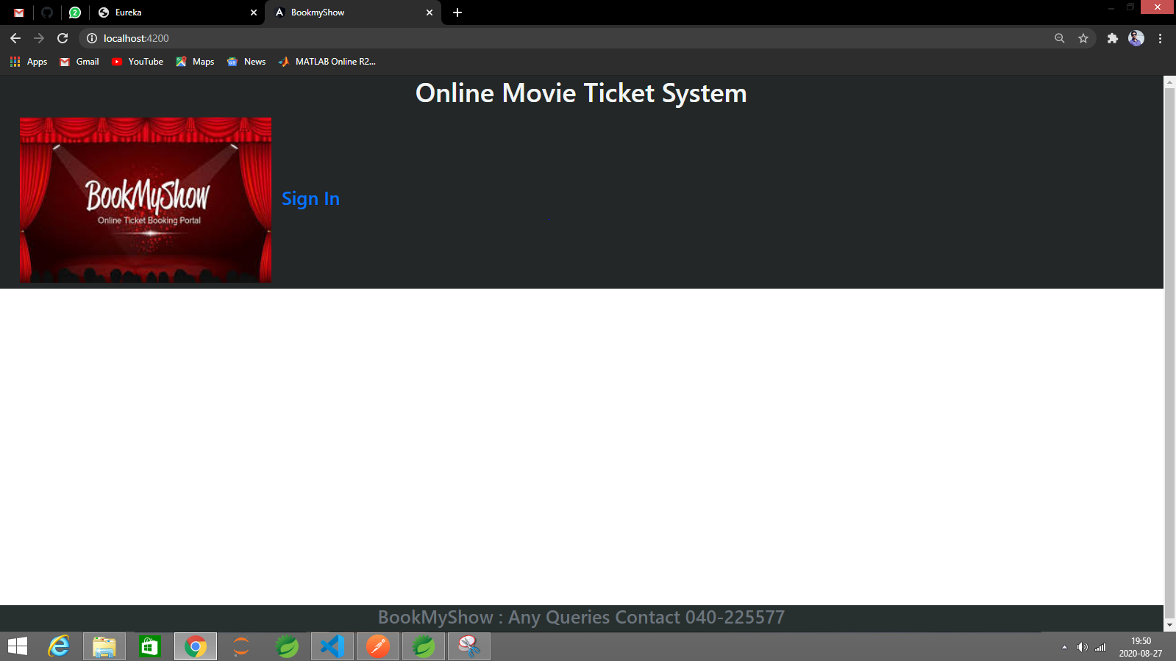
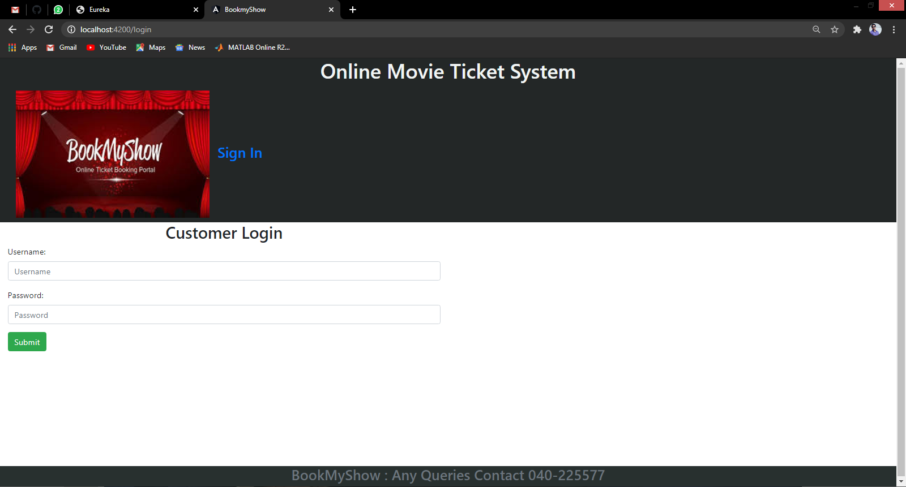
1.Main Page
2.Login Page

Slide 6
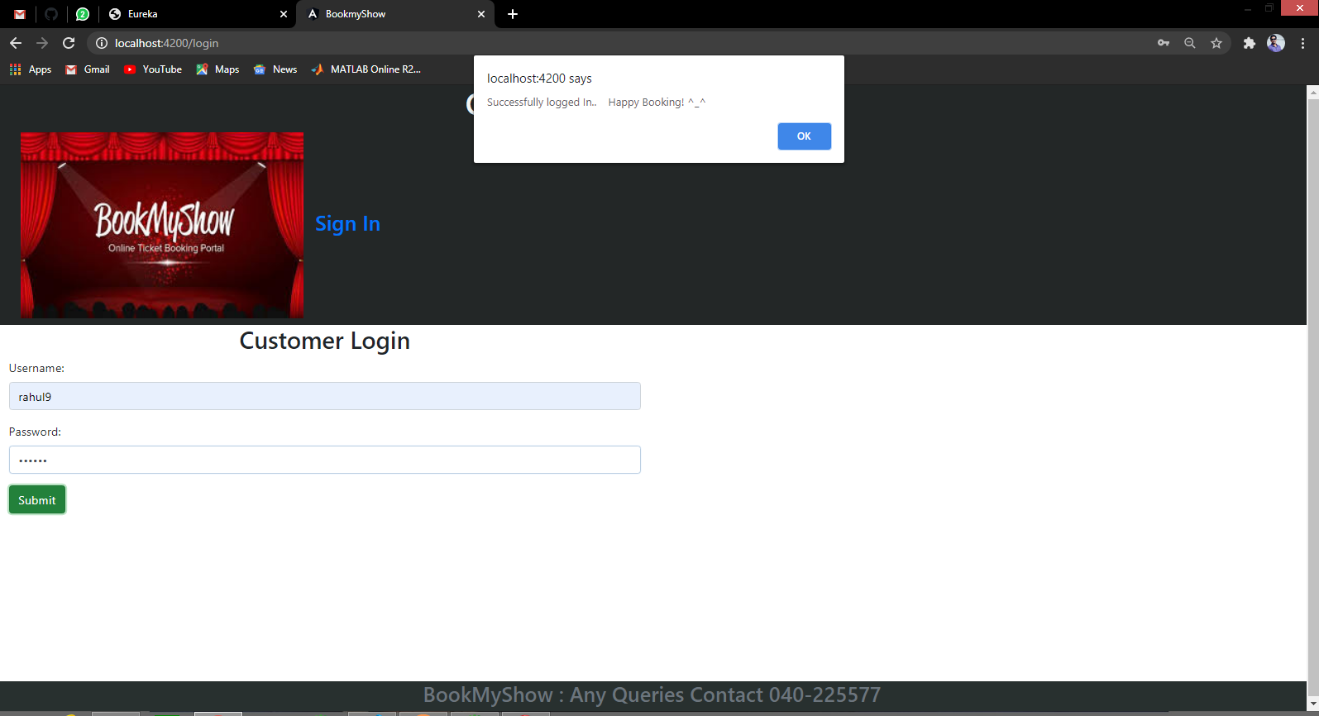
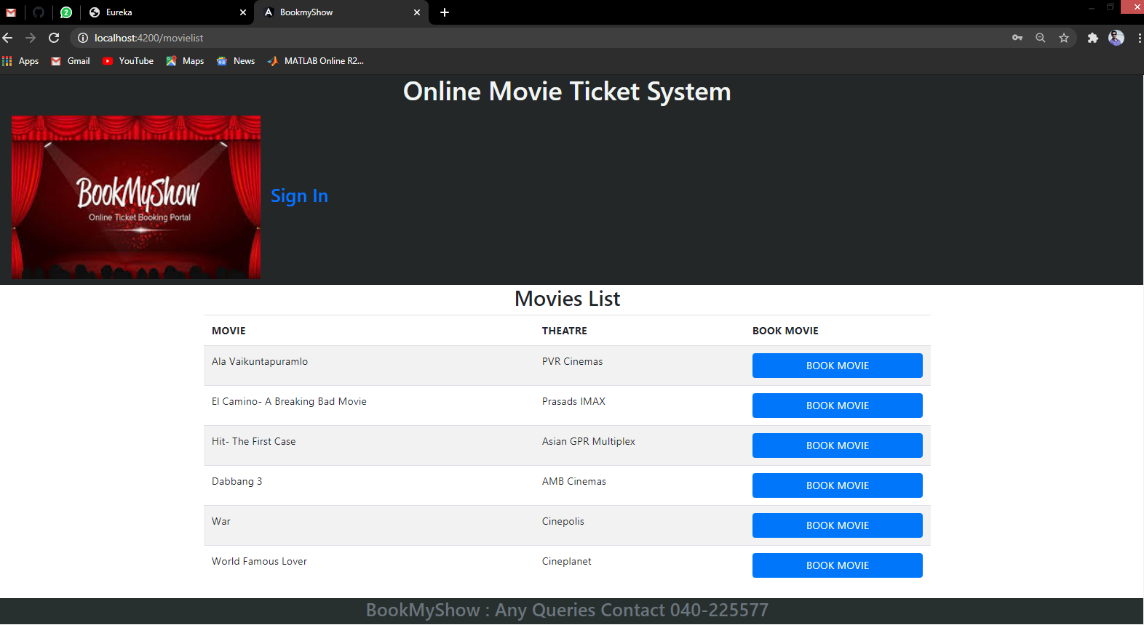
3.Login Success Page
4.Movies List

Slide 7
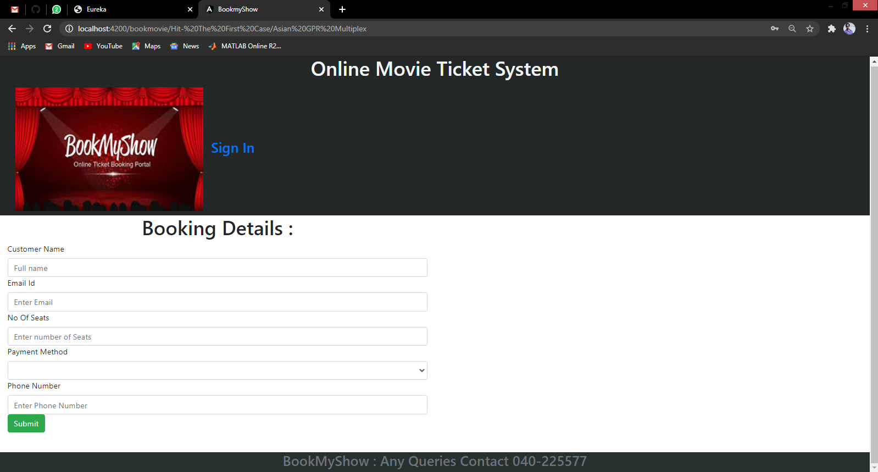
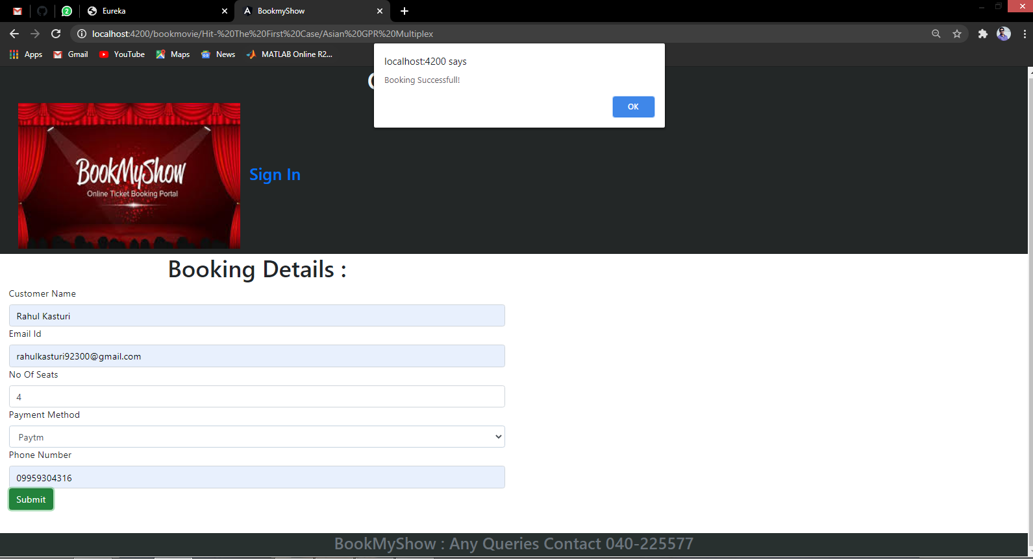
5.Booking Details
6.Booking Success

Slide 8
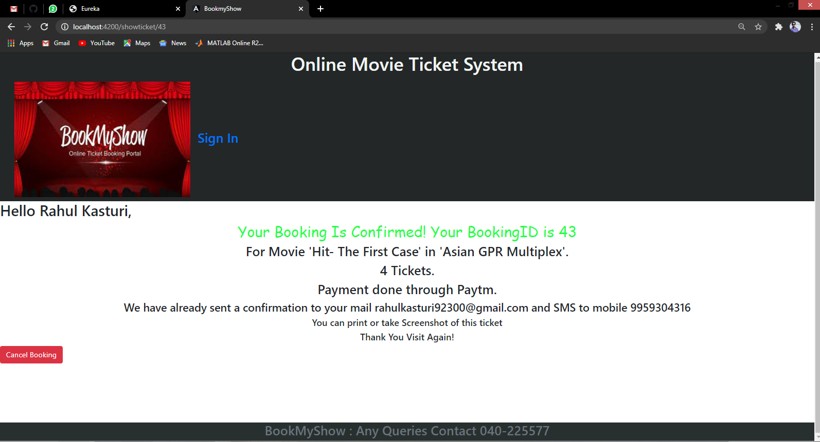
7.Ticket Display

Slide 9
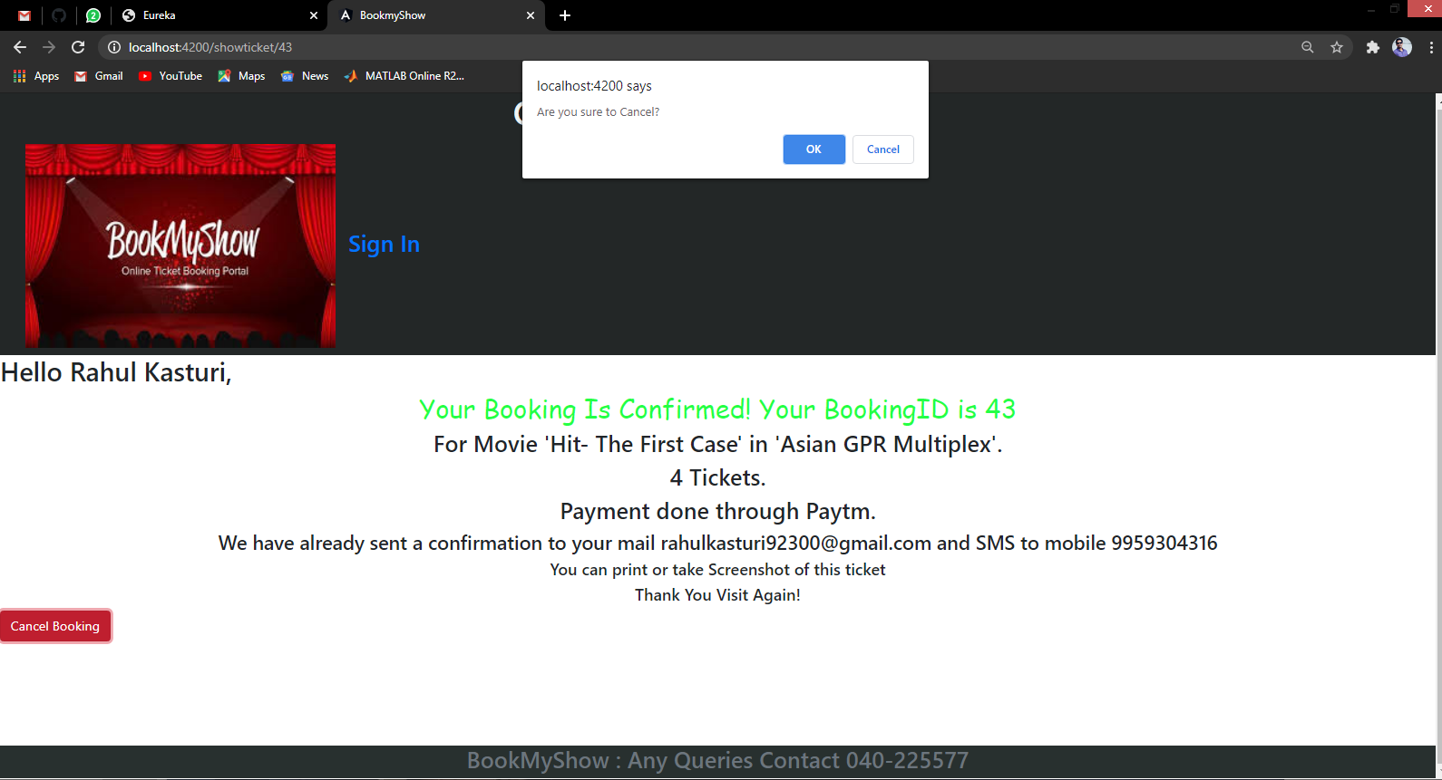
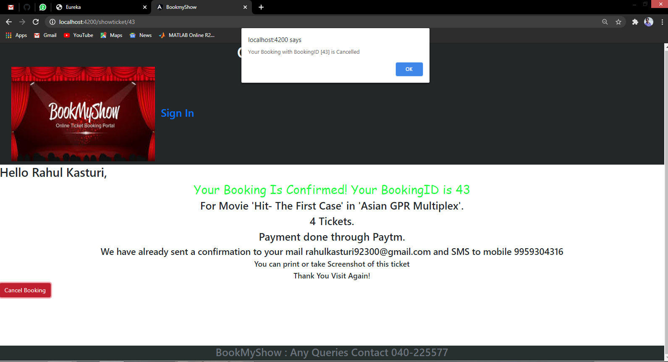
8.Booking Cancellation
9.Booking Cancelled

Slide 10
Thank You

